Slide 1


CoinExpo - A Cryptocurrency Prices Web App
MINOR PROJECT
Under the Supervision of:
Prof.Manoj Gupta
Submitted By: Varun Bairagi (0827CT191062)
Vidhi Sethiya (0827CT191063)
Yashika Khatri (0827CT191066)
Department of Computer Science and Information Technology
Acropolis Institute of Technology and Research, Indore

Slide 2

CoinExpo - A Cryptocurrency Prices Web App

Slide 3
WHAT IS OUR PROJECT IDEA
WHY CRYPTOCURRENCY ?
Cryptocurrencies are becoming increasingly popular and will become highly valuable in the future. Because cryptocurrencies are fast, it allows for quicker and safest transactions.
In addition, cryptocurrency is decentralised, which makes it trustworthy. A large number of companies and brands have begun to accept cryptocurrency as a payment method.

Slide 4
So we are developing a web app that will be very helpful and efficient for those who are interested in cryptocurrency as this project will help you to check prices of various cryptocurrencies.
Along with modifications in prices on daily basis and it will also compare the prices and exchange rates of different currencies.

Slide 5
WHAT DOES IT DO ?
It accesses prices, exchange rates and historical trade data.
It will present scraped data graphically.
It will display correct information about current as well as previous performance of different cryptocurrencies.

Slide 6
HOW WILL IT WORK
Collect data
USERS
FRONTEND
What user sees and interact with.
Request
WEB SERVER
Python, APIs
Display results
Respond
FILES
DATABASE

Slide 7
PROJECT CATEGORY
DATA ANALYSIS BASED WEB APPLICATION
Our project is a Web App which is the process of using client-side and server-side programming to develop an application accessible over a web browser.
We have also focused on Data Analysis and Data Visualization.
Which is the process of applying statistical techniques to illustrate and evaluate data with graphical depiction of information and data using visual components such as graphs and maps.
Trends, anomalies, and patterns in data can be seen and understood using data visualisation.
Data analysis tools and technologies are critical in the Big Data environment for analysing enormous volumes of data and making data-driven decisions.

Slide 8
PROJECT OBJECTIVES
● To access prices and exchange rates.
● To help users get correct information.
● Present the data of different cryptocurrencies statistically.

Slide 9
PROJECT REQUIREMENTS
TOOLS AND TECHNOLOGIES -
Python 3.0
Streamlit, Matplotlib, Pandas, NumPy
Heroku

Slide 10
PROJECT REQUIREMENTS
HARDWARE REQUIREMENTS -
1. Modern Operating System:
a. Windows 7 or 10
b. Mac OS X 10.11 or higher, 64-bit
c. Linux: 64-bit
2. x86 64-bit CPU (Intel / AMD architecture)
3. 4 GB RAM
4. 5 GB free disk space

Slide 11
PROJECT MOTIVATION
Many people find cryptocurrency difficult to understand so, we have undertaken this project so that it will be convenient for cryptocurrency enthusiasts to use and understand cryptocurrency simply. Whether you have to discern prices, compare prices, see the changes in prices, conversion of currency or know the summary, all can be done in one place.

Slide 12
PROJECT STAKEHOLDERS
This project is extremely beneficial for individuals who are
Crypto enthusiasts
Investors
Newbies who wish to enter into the crypto pool.

Slide 13
PROJECT MODULE
MODULE 1
MODULE 2
MODULE 3
MODULE 4
Researching about different APIs to use.
Studying documentation.
Preparing Synopsis and
Presentation.
Learning Python.
Studying, implementing
and working with different
python libraries.
Implementation and testing frontend with Streamlit.
Designing user-friendly UI.
Final coding, integration
and testing of web app.
Result analysis.
Deploying the web app.

Slide 14
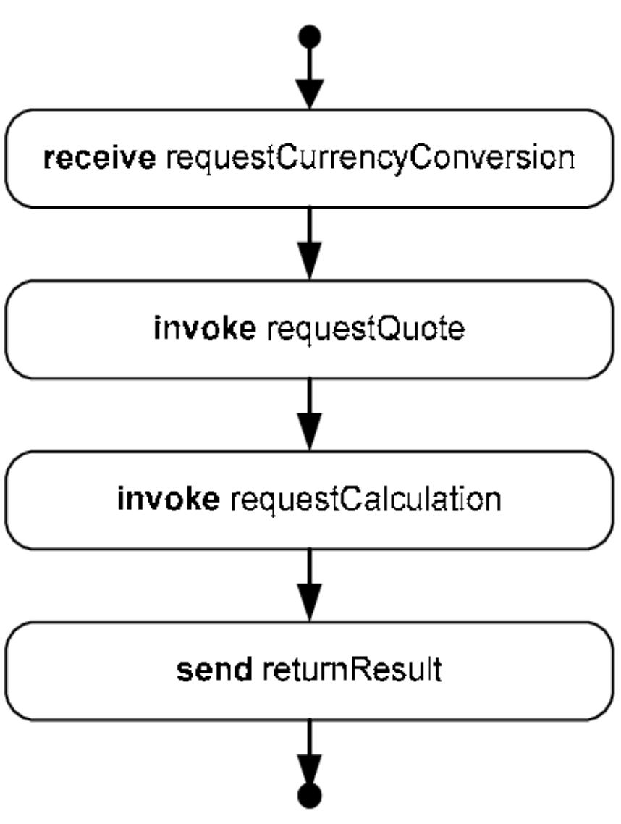
Activity Diagram

Slide 15
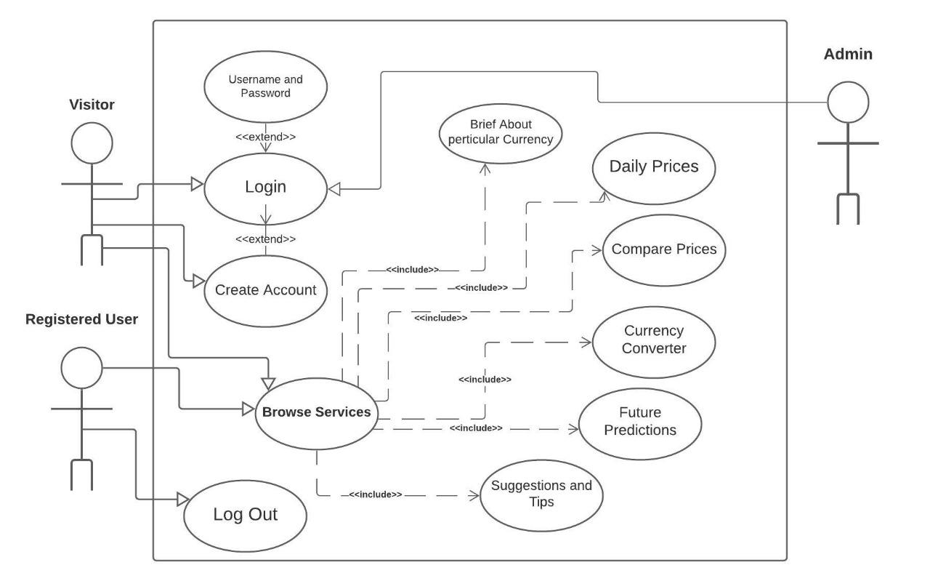
Use Case Diagram

Slide 16
TEAM MEMBER AND THEIR EXPERTISE
Student Name and Enrollment No. | Technical Expertise
Varun Baragi (0827CT191062) | Frontend, Python, APIs
Vidhi Sethiya (0827CT191063) | Python, APIs
Yashika Khatri (0827CT1919066) | Frontend, Python
.

Slide 17
CONCLUSION
This Web App :
Will show cryptocurrency prices, exchange rates and history.
Will help crypto enthusiasts and newbies to explore, compare different currencies.
Currency converter add-on will help you get your calculations done all in one place.

Slide 18
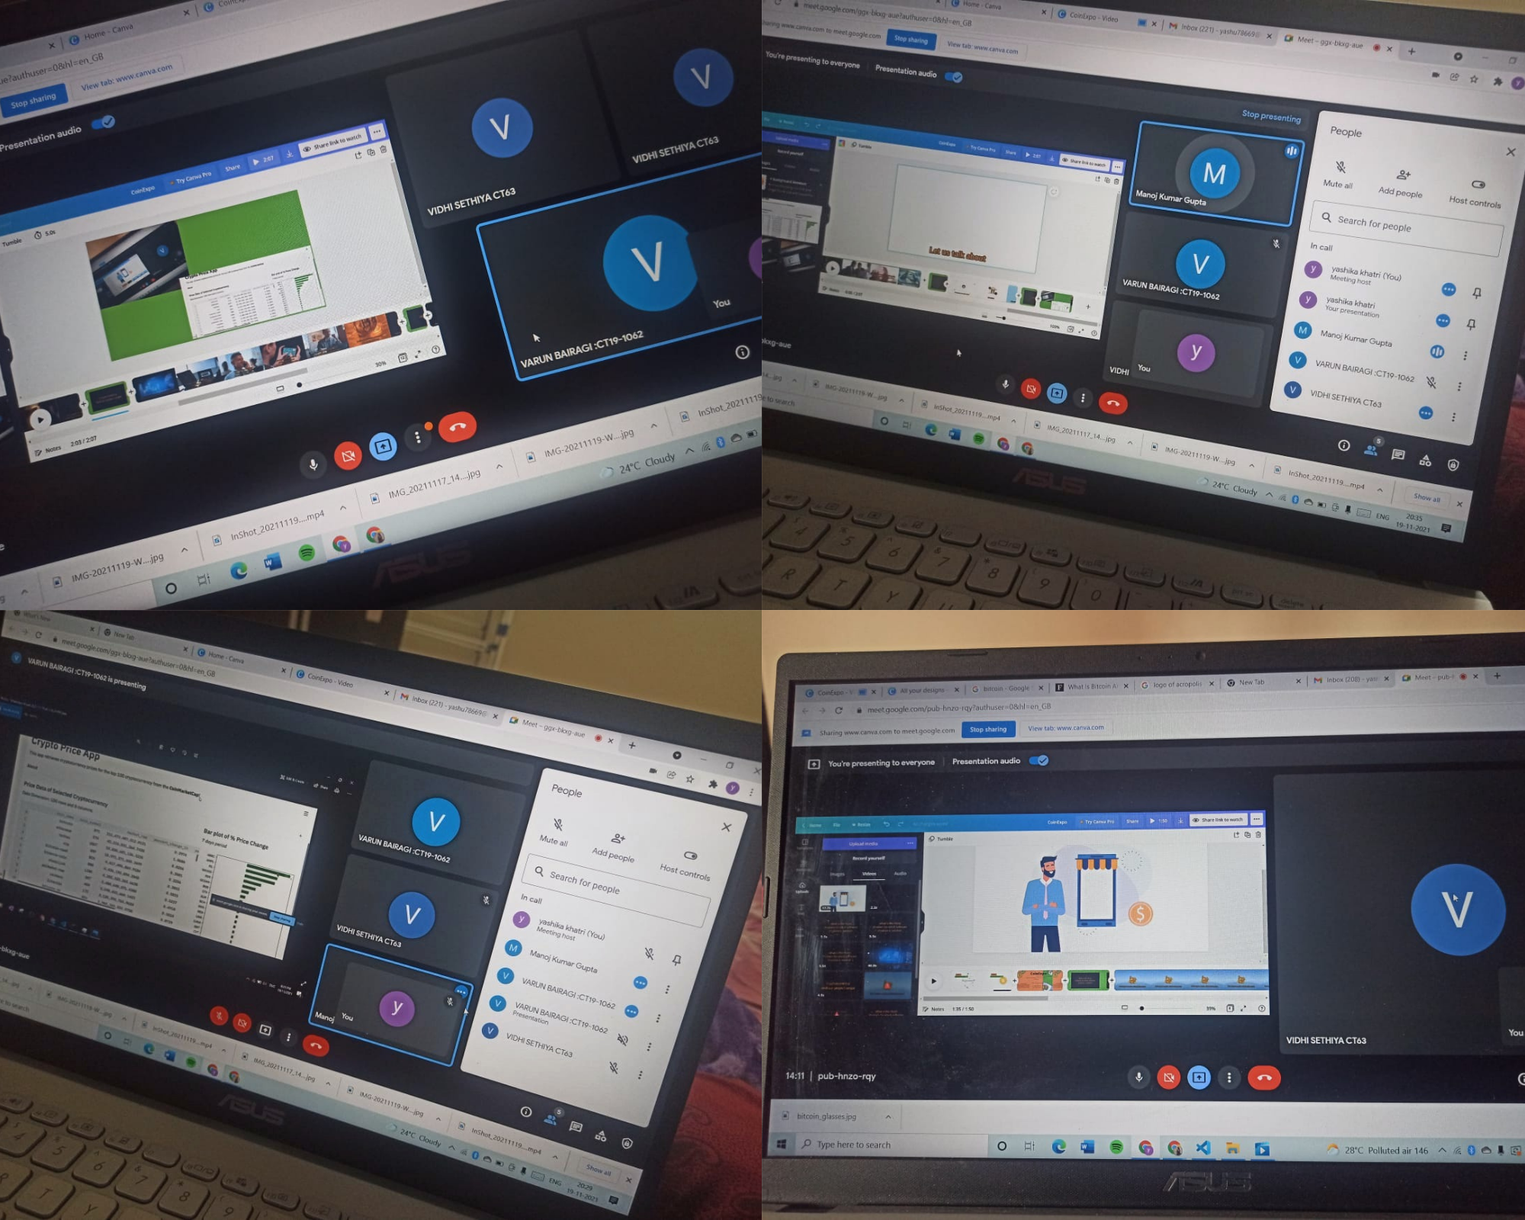
LOG NOTE

Slide 19
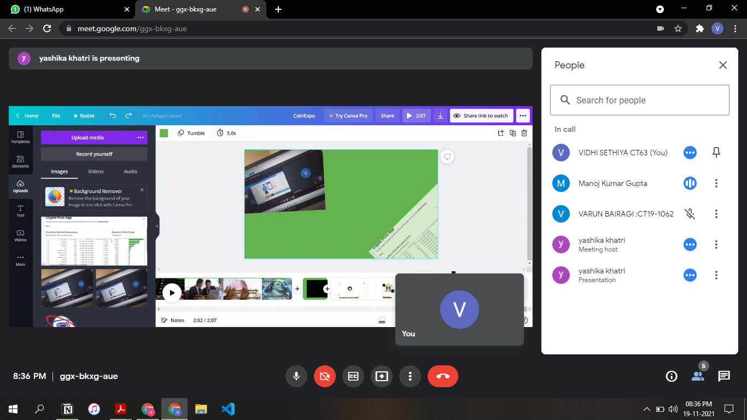

Slide 20
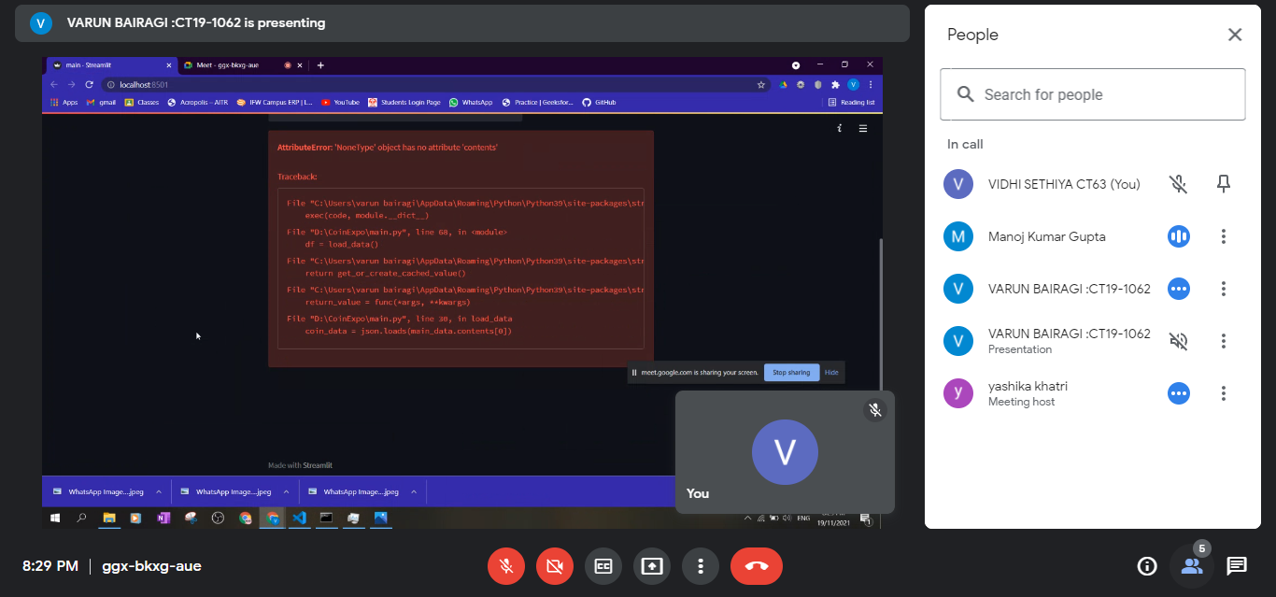

Slide 21
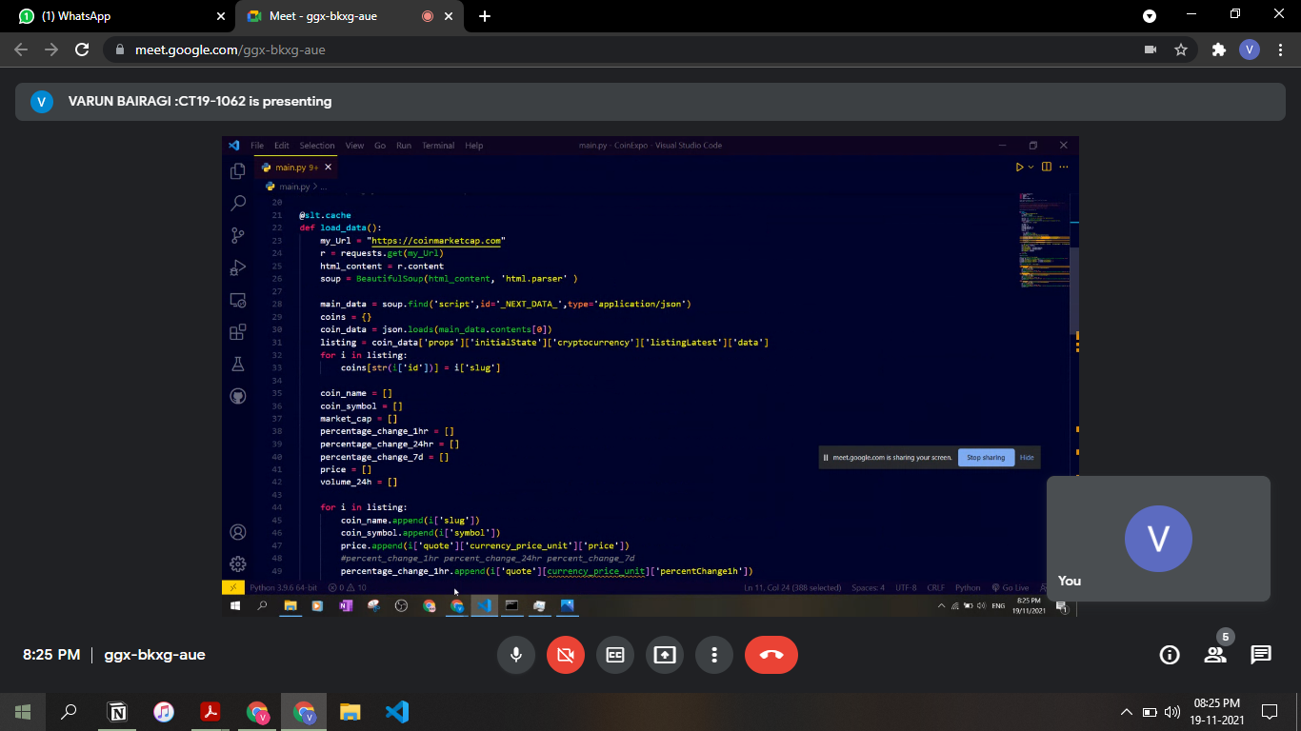

Slide 22
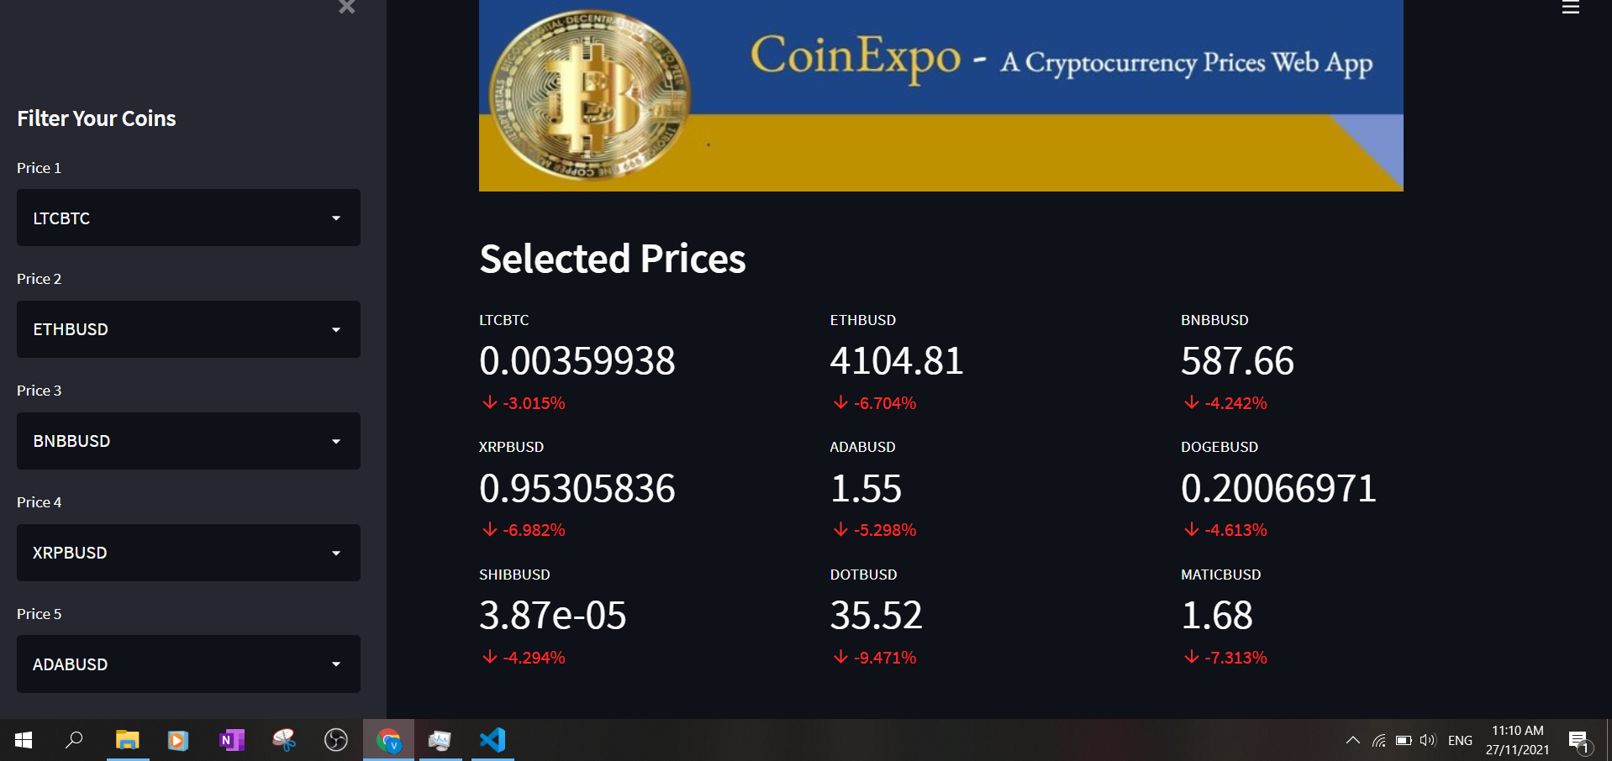

Slide 23


